Slide 1

PCCGR Aug 12, 2025: Update on Hypercapnic Respiratory Failure Care at Intermountain
Brian W Locke MD MSCI
Assistant Professor
Shock Trauma ICU and Schmidt Chest Clinic
Pulmonary and Critical Care, Intermountain Medical Center
COI: Mountain Biometrics (time-series machine learning on continuous sensor data)
Funding for this work:
American Thoracic Society Academic Sleep Pulmonary Integrated Research/Clinical Fellowship
NIH NHLBI T32 University of Utah PCCM
Intermountain Fund PCCM Seed Grant: Follow-Up Needs after Discharge with Hypercapnia (FUND-Hypercapnia)
Partial support for datasets within the Utah Population Database provided by the Huntsman Cancer Institute (HCI) & HCI Cancer Center Support grant P30 CA2014 from the National Cancer Institute
Notebook on Hypercap. R.F.
Notes:
Transcript of the talk: (dictated, forgive errors)
My name is Brian Locke. I’m an assistant professor working in the Shock Trauma ICU and the Schmidt Chest Clinic, and today I’m giving an update on hypercapnic respiratory failure. I have a conflict of interest with a local startup doing machine learning unrelated to this talk. I want to acknowledge support from the American Thoracic Society, the NIH, and our Pulmonary and Critical Care Medicine seed grant, and to thank the Utah Population Database and its funders. For those following along in NotebookLM, Google’s large language model environment, I’ve uploaded key literature so you can query or review the synthesized notes while we go.
I’ll start with background and the current state of hypercapnic respiratory failure, move to what we’re doing clinically and in research, and end with new CMS national coverage determinations for respiratory assist devices and home mechanical ventilators—changes most private payers will soon mirror—so we can discuss how to qualify patients for devices.
First, definitions. Hypercapnic respiratory failure is a syndrome—the pattern of signs and symptoms that accompany a CO₂ level that is too high—reflecting failed homeostasis: an imbalance between tissue CO₂ production and alveolar ventilation that allows PaCO₂ to rise. Hypercapnia itself is a finding defined against the distribution of normal values. Because “normal” shifts with altitude, the threshold for abnormality is lower here than at sea level; using 41–42 mmHg in Salt Lake City is appropriate. Payers don’t adjust coverage criteria for elevation, which may not matter for borderline cases clinically, but it matters for how we interpret a clinic PaCO₂ of 43–44 mmHg locally—that’s abnormal. Although one might imagine adding criteria (for example, excluding cases where elevated PaCO₂ is a proportional response to metabolic alkalosis—what I’d call “respiratory success”), TriNetX data suggest isolated, compensatory hypercapnia is rare. In practice, the syndrome is defined by a high CO₂.
I prefer the term ventilatory failure because homeostasis can fail without overt hypercapnia when the physiologic context calls for a lower PaCO₂. The framework I use is supply versus demand: can the patient sustain the ventilation the situation requires? Demand depends on three variables: the dead-space fraction (the portion of each breath wasted for CO₂ exchange), tissue CO₂ production, and the target PaCO₂ appropriate to the situation. If dead space increases, required ventilation rises. If CO₂ production rises, required ventilation rises proportionally. If the target PaCO₂ is lower, required ventilation climbs nonlinearly.
Supply—the maximal sustainable ventilation—depends on respiratory muscle capacity and mechanical advantage, the stability of respiratory control, and the loads on the system. Loads include resistive loads (like breathing through a straw), elastic loads (inflating a stiff lung or chest wall), and, in many acute settings, threshold and inertial loads. Opioids and sleep alter control stability; COPD with hyperinflation, neuromuscular disease, and pleural or chest wall disease alter mechanics. Patients whose chronic loads push them close to their sustainable limit have little physiologic reserve. Think of a person with COPD whose FEV₁ is well under a liter: a small increase in demand can precipitate failure. Those are the patients who need close attention, as highlighted by prior work in this area.
It’s worth dwelling on the goal PaCO₂. Mathematically, a higher PaCO₂ target lowers required ventilation, which can seem counterintuitive. Elevated CO₂ signals a response to some underlying stress, but from a mechanics standpoint, higher alveolar CO₂ allows each exhaled breath to carry a higher CO₂ concentration, reducing the total ventilation needed to maintain steady state. That’s the rationale for permissive hypercapnia in lung-protective ventilation: allowing PaCO₂ to rise lets us reduce ventilatory pressures. Evidence from ECMO cohorts and from patients with kidney injury suggests that for a given CO₂ rise, lack of metabolic compensation portends worse outcomes in ARDS, partly reflecting multi-organ failure and partly the ongoing mechanical stress on lungs. This raises a question: if higher PaCO₂ lowers ventilatory work and pH can be maintained at any PaCO₂ with sufficient bicarbonate, why isn’t the set point much higher—why not a PaCO₂ of 90 with a bicarbonate of 45? The answer likely lies in oxygen. By the alveolar gas equation, CO₂ “occupies space” that would otherwise contribute to alveolar oxygen; at room air (FiO₂ 0.21), a higher PaCO₂ erodes the oxygenation buffer. The transition from acute to chronic hypercapnia seems to involve a control-system calculation that balances the effort of breathing against the cost of reduced oxygen margin. In chronic respiratory failure, the old “can’t breathe/won’t breathe” dichotomy doesn’t help.
Severe hypercapnia as a survivable state is relatively new in medicine. Before supplemental oxygen, significant hypercapnia generally meant death. Only about 75 years ago did clinicians begin to recognize and treat it. Hannah Wunsch’s The Autumn Ghost recounts how, during the early polio epidemics, somnolence and unresponsiveness were attributed to encephalitis (“cerebrelia”) until clinicians provided manual positive-pressure breaths and patients woke up—revealing CO₂ retention as the true cause and inaugurating modern critical care.
I argue that hypercapnic respiratory failure management is a large, solvable, and neglected problem. On scale: an Australian study in the Blue Journal estimated a population-standardized period prevalence of PaCO₂ ≥45 mmHg (excluding iatrogenic causes) of 150 per 100,000 person-years—higher than decompensated cirrhosis in the United States, which is roughly 100 per 100,000. A limitation is that not every patient with hypercapnia gets a blood gas, so ascertainment is imperfect. The only study I know that checked blood gases without clinical indication—a 2005 Denver VA study of consecutive admissions with BMI ≥35—found elevation-adjusted hypercapnia in about a third of patients, with only about one in ten recognized clinically.
Our group used the Utah Population Database to estimate pre‑COVID yearly period prevalence of ICD codes for hypercapnic respiratory failure in Utah; there were about 4,000–5,000 codes per year across five primary codes, which normalizes to roughly 150 per 100,000—again, in that same ballpark. TriNetX analyses help interpret this: among patients with hypercapnia on blood gas, about a third in the ED and about 40% in inpatient settings receive an ICD code for hypercapnic respiratory failure, suggesting code-based counts may underestimate the true burden by up to a factor of three.
Outcomes are concerning across etiologies. A single-center study from Vermont of inpatients with an ICD code for hypercapnic respiratory failure showed a 30‑day readmission rate of about 25%, similar to heart failure and higher than myocardial infarction, with two-thirds readmitted for recurrent hypercapnia. In the Michigan health system, even compensated hypercapnia on blood gas was associated with increased mortality; a PaCO₂ in the 50–65 mmHg range carried a risk roughly comparable to decompensated cirrhosis, with higher PaCO₂ worse and milder elevations somewhat better. In TriNetX data, among about 30,000 patients with hypercapnic respiratory failure codes (mean age ~65), two‑month mortality was 20% and climbed to about 30% by nine months.
These patients are also expensive to care for. Office of Inspector General reports document dramatic growth in use of home mechanical ventilators and noninvasive respiratory assist devices beginning around 2013, with more than a hundred‑fold increases relative to 2009 baselines. Comprehensive cost estimates are lacking, which is why one of our first seed‑grant projects is an economic analysis linking Intermountain Health records to Select Health claims. We call this AIM‑HIGH (Artificial Intelligence for Modifiable Health Indicators in Groups with High Needs), starting with hypercapnic respiratory failure and extending to other high‑utilization conditions, using machine learning to identify patients at risk and intervene.
Therapeutic options exist, although the evidence base is uneven. Guidelines for obesity hypoventilation recommend treatment despite surprisingly low levels of evidence. There are randomized trials in neuromuscular weakness (and in cystic fibrosis, though not discussed today), and there is a dozen‑plus trials of long‑term noninvasive ventilation in chronic stable hypercapnic respiratory failure that are generally supportive when done appropriately. It is not all NIV. Weight‑loss interventions matter for the sleep‑disordered breathing component of hypercapnia. The FDA has approved tirzepatide for obstructive sleep apnea, and our meta‑analysis shows a dose‑dependent improvement in OSA with both surgical and medical weight loss. Although we don’t yet know the exact fraction of hypercapnia attributable to sleep apnea, several cohorts that systematically tested ICU survivors of hypercapnic respiratory failure found that the majority had moderate to severe OSA. Even outside strict OHS definitions, sleep apnea likely plays a substantial causal role that we systematically miss without testing.
These needs have prompted a movement to formalize a subspecialty in chronic respiratory failure. An AnnalsATS piece last year makes the case: roughly 300 clinicians nationwide specialize in managing chronic respiratory failure—far too few for current needs—and care requires both device expertise and structured processes around DME ordering and respiratory therapy support. Subspecialty designation could solidify a research paradigm and allow us to advocate for structural changes.
Two evidence gaps hinder effective care. First, real patients usually have multiple contributing causes for hypercapnia, but most trials target single‑cause cohorts. Trials of hypercapnic COPD often enroll patients with average BMIs around 25 and exclude comorbid sleep apnea; the definition of OHS, in turn, excludes patients with even modest contributions from heart failure or COPD. What should we do for someone with COPD, heart failure, and sleep‑disordered breathing? The evidence rarely applies cleanly, so we extrapolate. Second, the evidence presupposes a definitive diagnosis, whereas in practice hypercapnic respiratory failure often precedes the diagnosis of the causative condition. Patients are admitted without prior spirometry, sleep testing, or sometimes even an established outpatient relationship; they’re stabilized and discharged; testing is ordered but often not completed; and care transitions create opportunities to fall through the cracks.
We examined statewide testing patterns using the Utah Population Database and the All‑Payer Claims Database (covering ~90% of commercially insured patients and ~70% of other care from 2015–2019). Among patients with inpatient or ED encounters coded for hypercapnic respiratory failure, roughly two‑thirds had an echocardiogram in the five years before the index event, but only about one in three had spirometry and about one in five had sleep testing. In the year after the event—including the index hospitalization—about half received an echocardiogram, but only ~one in eight had spirometry and ~one in ten had sleep testing. These figures likely underestimate testing only slightly (e.g., in‑migrants), and they underscore a system‑level gap. Our CO₂‑PATH cohort (Post‑Acute Trajectories of Hypercapnia) is designed to define the denominator rigorously, follow trajectories after discharge, benchmark testing and outcomes across the state, and, crucially, help distinguish frailty markers from ventilatory targets that can alter risk.
The usual post‑discharge workflow helps explain low completion rates. An inpatient team prescribes a home mechanical ventilator; the DME company receives the order and sends a respiratory therapist to set up equipment and educate the family; referrals go to PDNs and to pulmonary clinic; PFTs are typically ordered before the pulmonary visit; sleep referrals are placed and often misunderstood by patients who presented with daytime dyspnea. Many steps occur before any specialist discussion, and each step can derail. This argues for two parallel efforts: measure how the system is performing now (CO₂‑PATH) and move toward risk‑based referrals and early empiric management when indicated.
Based on ICD counts, I estimate 5,000–6,000 hypercapnic respiratory failure cases present to acute care or ED settings within Intermountain annually. Not all require specialty care—some are transient, iatrogenic, or manageable in primary or general pulmonary care—but we need to identify the subset at high risk of readmission if we don’t intervene. AIM‑HIGH, which links Intermountain clinical data with Select Health claims, is designed to stratify that risk and target resources.
In the Schmidt Clinic, I spend most of my time managing chronic respiratory failure. Our three main referral streams are high‑risk post‑discharge patients via the pulmonary disease navigators (Claire Davies and Megan Hepworth), internal referrals for potential NIV starts, and a neuromuscular clinic. We don’t have an ALS center at Intermountain, so those patients go to the university, but other neuromuscular patients come to our clinic. We could accept more referrals from PM&R, post‑acute facilities, and patients initially triaged to sleep clinics for suspected OHS who are ultimately determined not to have a primary sleep‑breathing disorder. Much of this care can be handled remotely. Device downloads provide rich information; paired with video visits, we can deliver high‑fidelity care and potentially expand our geographic reach.
To close, I want to clarify device categories and the new coverage rules. “Respiratory assist device” is a term coined when CPAP for sleep apnea and hospital ventilators had distinct roles; CMS wanted to avoid paying for home ventilators for the entire sleep apnea population. The community adopted “RAD” to signal that these were not ventilators. The technology has matured: modern RADs can do bilevel, backup rates, and volume‑assured pressure support (volume‑targeted pressure support). Some capabilities still require a home mechanical ventilator, such as AVAPS‑AE (volume assurance with adjustable EPAP) and other advanced modes used in severe disease. RADs typically cap maximum inspiratory pressures around 30 cm H₂O, which sounds high until you recall that contemporary COPD NIV trials have mean IPAPs in the mid‑20s and about a quarter of patients above 30. RAD settings can be changed remotely; HMV settings generally cannot. RADs are capped‑rental and eventually owned by the patient; HMVs fall under frequent‑and‑substantial‑servicing rental and include bundled respiratory therapy support.
Historically, RAD qualification pathways were fragmented (restrictive thoracic disorders, hypercapnic COPD, hypoventilation), with requirements that often didn’t match the indication—for example, obligate nocturnal hypoxemia in COPD candidates. CMS recently approved a new national coverage determination. Neuromuscular criteria are unchanged: a qualifying diagnosis plus either hypercapnia, nocturnal hypoxemia, or spirometry criteria. The COPD bucket is now effectively “all chronic respiratory failure,” which is confusing but pragmatic. There are two paths: outpatient and discharge. The outpatient path doesn’t require PFTs; it does require stable daytime PaCO₂ ≥52 mmHg and a determination that sleep apnea isn’t the sole cause (not necessarily proven by polysomnography or nocturnal oximetry). The discharge path requires full RAD settings documented within 24 hours of discharge and a clinical judgment that the device is needed to avoid symptoms or rapid CO₂ rise. Both paths now include re‑qualification every six months, including average use of at least five hours per 24 hours and documented improvement in CO₂, exacerbations, or symptoms—which will increase clinic volume and require workflow adjustments.
HMV previously had an easier bar: a qualifying condition plus a statement that interruption of support would quickly lead to serious harm or death. That disparity helped drive HMV use upward, not always because patients needed ventilators, but because RAD qualification was onerous. Under the updated rules, neuromuscular indications for HMV are unchanged. For non‑neuromuscular chronic respiratory failure, the outpatient path now requires meeting RAD criteria plus at least one additional need (an advanced mode, higher IPAP requirements, or failure of RAD), and in our setting, oxygen needs above roughly 36% (about 4 L/min) can also support the case when combined with one of those criteria. The discharge path hinges on documented inpatient use of the HMV within 24 hours and capabilities that exceed what a RAD can provide, with full settings documented. Ongoing follow‑up requirements align with those for RADs.
If you’re interested in collaborating on hypercapnia research, have ideas about referrals, or want to discuss specific patients, please reach out in the EHR (soon via Epic) or by email. This is a team effort: our pulmonary disease navigators, Claire Davies and Megan Hepworth, do a tremendous amount of the day‑to‑day work, and our research partners span Intermountain, Select Health, the University of Utah, and UC Davis. I’m happy to take questions.

Slide 2
Agenda
01 | The problem: Hypercapnic Respiratory Failure Management…🤷‍♂️
02 | Intermountain Hypercapnic Respiratory Failure Research Agenda
03 | Intermountain Hypercapnic Respiratory Failure Clinical Agenda
04 | New National Coverage Determinations for DME

Slide 3
Hypercapnic Respiratory Failure:
Hypercapnia is a finding; Failure indicates failed homeostasis
Finding: Hypercapnia == PaCO₂ ≥ expected range
45 mmHg (at sea level); 41-42 mmHg in SLC
Threshold based on abnormality (like FEV1), not consequence (like blood pressure)
Failure: a syndrome (pattern of signs/symptoms)
“Failure” implies failed homeostasis – an imbalance between VCO₂ and V_{a}
Not explainable by metabolic alkalosis (respiratory success)
There’s no operational definition beyond hypercapnia
Notes:
Nation-wide <1% of hypercapnia is “hypercapnic respiratory success” per trinetx data

Slide 4
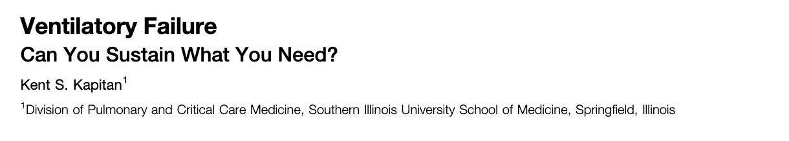
$$Required Ventilation ∝Ventilation Wasted+ \frac{Tissue Production of CO2}{PaCO2 Target∗}$$
$$Maximum Sustainable Ventilation= F(Muscle Capacity, Control Stability, Respiratory System Loads)$$
Demand and Supply
Demand depends on V̇CO₂, Vd/Vt, target PaCO₂;
Supply depends on muscle capacity, mechanics, control stability, loads.
Supply-Demand mismatch == respiratory failure
Notes:
Just like cardiac output receives too much attention compared to venous return; oxygen transport receives too much attention compared to carbon-dioxide flux
— a schema for thinking about ventilatory failure - from the “Ventilatory Failure: can the body sustain what it needs”? in AnnalsATS
Abnormal PaCO2 => the balance of tissue CO2 production (VCO2) to alveolar ventilation (Va) is off.
https://www.atsjournals.org/doi/10.1513/AnnalsATS.201305-132OT?url_ver=Z39.88-2003&rfr_id=ori:rid:crossref.org&rfr_dat=cr_pub%20%200pubmed

Slide 5
$$Required Ventilation ∝Ventilation Wasted+ \frac{Tissue Production of CO2}{PaCO2 Target∗}$$
$$Maximum Sustainable Ventilation= F(Muscle Capacity, Control Stability, Respiratory System Loads)$$
Variable | V_{d} | VCO₂ | Goal PaCO₂
Pathophys. | Deadspace Fraction | Met. Rate & Resp Quot. | Compen-sation
Examples | PE, Parenchymal Lung, Anatomic | Overdose, Overfeeding, Obesity | Met. Acidosis/Alkalosis

Slide 6
$$Required Ventilation ∝Ventilation Wasted+ \frac{Tissue Production of CO2}{PaCO2 Target∗}$$
$$Maximum Sustainable Ventilation= F(Muscle Capacity, Control Stability, Respiratory System Loads)$$
Variable | V_{d} | VCO₂ | Goal PaCO₂ | Muscle Capacity | Control Stability | Respiratory System Loads
Pathophys. | Deadspace Fraction | Met. Rate & Resp Quot. | Compen-sation | Strength, Mech Advantage | Chemoreflex & breath generator | Resistive, Elastic, Threshold/Inertial
Examples | PE, Parenchymal Lung, Anatomic | Overdose, Overfeeding, Obesity | Met. Acidosis/Alkalosis | NMD, COPD, Pleural Dz | Opiates, Sleep | COPD, CHF, OHS

Slide 7
Ventilatory frailty endotypes
Baseline Req == Max
Predisposed to ↑ Req
Predisposed to ↓ Max
$$Required Ventilation ∝Ventilation Wasted+ \frac{Tissue Production of CO2}{PaCO2 Target∗}$$
$$Maximum Sustainable Ventilation= F(Muscle Capacity, Control Stability, Respiratory System Loads)$$
Req.
Max.
Variable | V_{d} | VCO₂ | Goal PaCO₂ | Muscle Capacity | Control Stability | Respiratory System Loads
Pathophys. | Deadspace Fraction | Met. Rate & Resp Quot. | Compen-sation | Strength, Mech Advantage | Chemoreflex & breath generator | Resistive, Elastic, Threshold/Inertial
Examples | PE, Parenchymal Lung, Anatomic | Overdose, Overfeeding, Obesity | Met. Acidosis/Alkalosis | NMD, COPD, Pleural Dz | Opiates, Sleep | COPD, CHF, OHS

Slide 8

Goal PaCO₂
$$Required Ventilation ∝Ventilation Wasted+ \frac{Tissue Production of CO2}{PaCO2 Target∗}$$
Q: Why is the goal PaCO₂ roughly 40 mmHg, and not higher?
pH can be maintained at any PaCO₂ with a certain HCO₃⁻
The process of adaptation is poorly understood… likely relates to the cost of less oxygen buffer vs. costs of breathing
Persistent severe hypercapnia is only possible since supp O₂
Coma in polio (1952) was “cerebrelia” - thought to be viral encephalitis – actually discovered to be hypercapnic RF.
Notes:
Each breath with a higher PaCO2 will contain more CO2 particles -> more efficient ventilation with higher blood CO2.
Ventilation is metabolically expensive- why not operate at a higher set point?
Hint: what is the evolutionary advantage of the goal PaCO₂ being lower in SLC (~33 mmHg) than sea level?
Consider: why does permissive hypercapnia work? (higher VE VCO2)
The mere existence of chronic hypercapnic respiratory failure tells you its not immediately fatal.
Chronic can occur if: The ventilatory control system has decided to tolerate a higher PaCO2, either because the feedback mechanisms aren’t working (opiates) or it’s suboptimal to try to defend the CO2 level (ie. metabolically expensive – severe COPD or OHS)

Slide 9
Hypercapnia in SLC
P_{A}O₂ = FiO₂ (P_{B}-47)—(PaCO₂/R) → O₂ 17.8 mmHg lower at 4500ft
SpO2 is routinely obtained in clinical practice, PaCO2 (or TcCO2) is not
SLC → earlier identification
Notes:
This also makes sense why these people might be so frail and prone to readmission… as your PaCO2 goes up, your buffer goes down. In fact, that’s probably why we’re evolved to hyperventilate with altitude. – called referred to as “ventilatory acclimatization” (92).
SpO2 <90% catches people’s attention
Corresponds to a PaO2 of ~55 mmHg (depending exactly on the individual’s oxygen hemoglobin dissociation curve.
Normal A-a gradient? 4 + (0.25 * Age)
Critical PAO2 = paO2 + (Normal A-a gradient)
Critical PAO2 = 51 + 0.25 * Age
PA_{O2} = (P_{atm} – P_{H2O}) * Fi_{O2} – (Pa_{CO2} / RQ) + Fi_{O2} * Pa_{CO2} * (1-RQ)/RQ
PA_{O2} = (650 – 47) * 0.21 – (Pa_{CO2} / 0.8) + 0.21 * Pa_{CO2} * (1-0.8)/0.8
PA_{O2} = 126.63 – (Pa_{CO2} / 0.8) + 0.05 * Pa_{CO2}
PA_{O2} = 126.63 – 1.3 * Pa_{CO2}
At 4500 ft:
PaCO2 = 58.17 - 0.19 * Age
At seal Level:
PaCO2 = 75.95 – 0.19 * Age

Slide 10
Hypercapnic Respiratory Failure management is a large, tractable, & neglected problem
Notes:
grant-making schema:
How big is the problem
How solvable is it?
How many people are working to solve it? (ie if we spend a bit more resources on this problem, will it make a difference?)

Slide 11
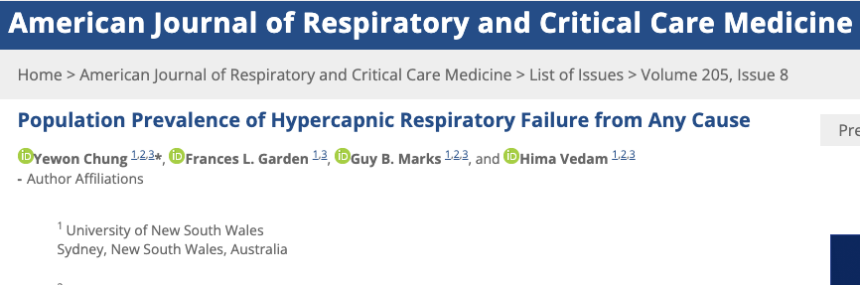
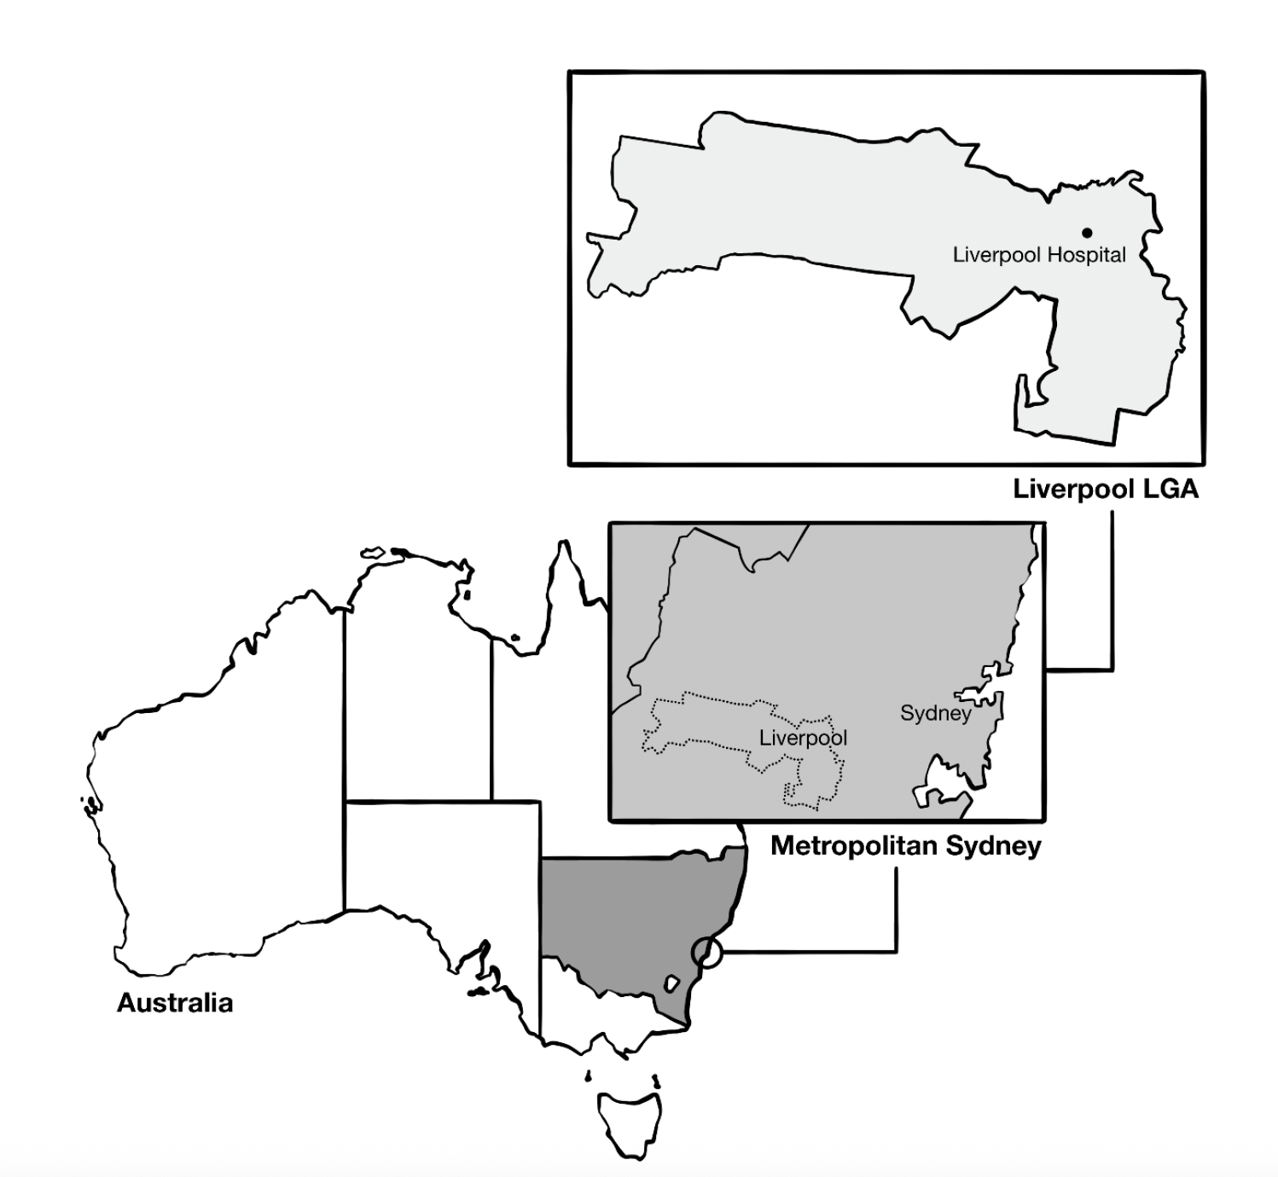
Hypercapnic Respiratory Failure is Common
Population-standardized period prevalence of PaCO₂ ≥ 45 mmHg (excluding iatrogenic causes):
150* per 100,000 person/year
Reference: Decompensated Cirrhosis 94.9 (US, 2017) per 100,000 person-year
Notes:
How common is hypercapnic respiratory failure?
— Chung et al estimate -

Slide 12
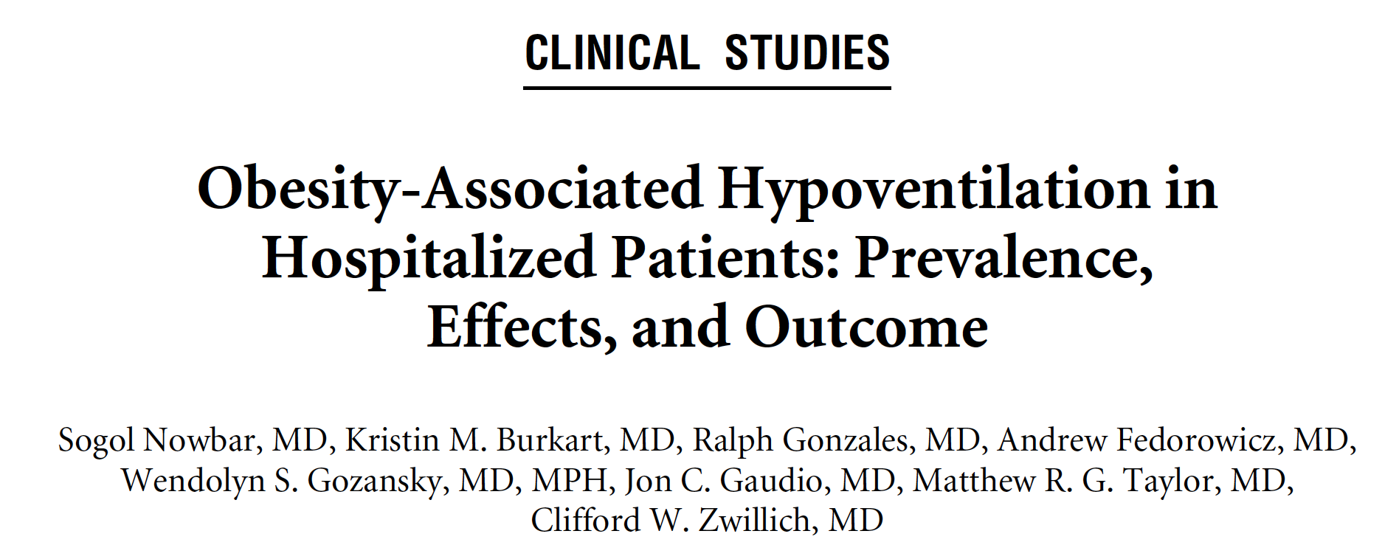
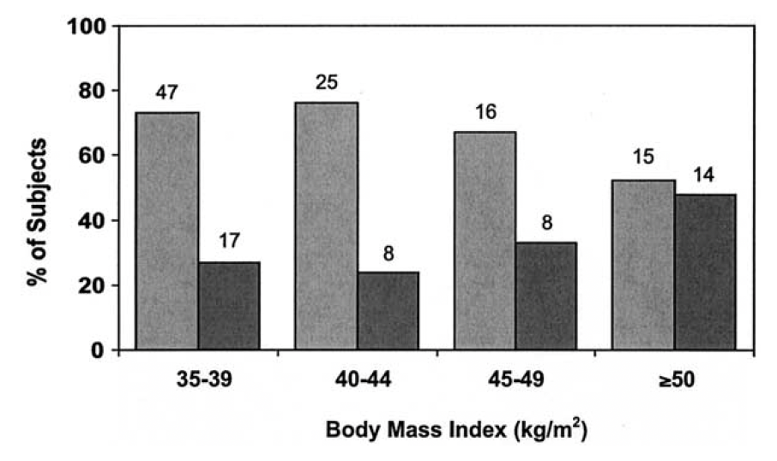
Hypercapnic Respiratory Failure is Common
Ascertainment
Population-standardized period prevalence of PaCO₂ ≥ 45 mmHg (excluding iatrogenic causes):
150* per 100,000 person/year
Reference: Decompensated Cirrhosis 94.9 (US, 2017) per 100,000 person-year
Denver VA. 277 consec admits BMI ≥ 35, all received ABG → 31% PaCO2 ≥ 42* mmHg
Notes:
How common is hypercapnic respiratory failure?
Nowbar 2005, : Of 277 patients with a BMI ≥35 kg/m² admitted to an inpatient medical service, Nowbar and colleagues⁴ found that 31% met criteria for OHS. when a subgroup of patients with BMI greater than 50 kg/m² was examined, OHS was found in 48%. Of particular concern, (though likely representative of many hospitals), effective therapy for hypoventilation was only instituted in 13% of these patients

Slide 13

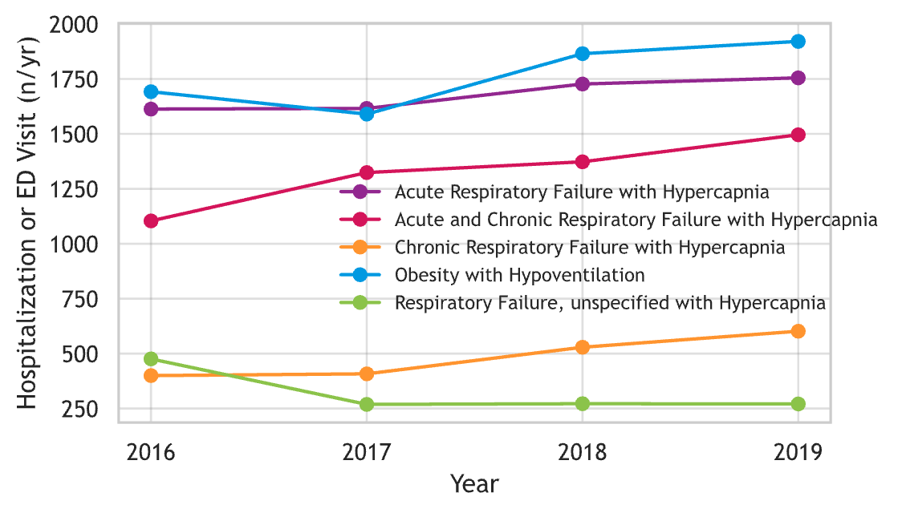
Hypercapnic Respiratory Failure is Common
Table 2 | 2016 | 2017 | 2018 | 2019
Any ICD, Period Prevalence (n) | 4064 | 4104 | 4520 | 4728
Cases per 100,000 (Utah pop.) | 133.5 | 132.2 | 143.3 | 147.6
Notes:
Hypercapnia cases already counted by ABG ≥ 45 mmHg
Derived earlier 5360
ABG obtained in ~36 % of acute‑care encounters that trigger any “hypercapnia work‑up”
TriNetX emulation dataset 0.363
A “VBG‑only” diagnostic strategy is common in ED settings and varies by region Case‑definition study narrative
qualitative
Proportion of all hypercapnic cases that are captured only by VBG (no same‑day ABG)
Plausible range informed by practice variation 20 – 40 %
Additional VBG‑only cases over 9 y
5360 × (0.20 – 0.40)
1070 – 2150
Revised total eligible cases by either ABG or VBG criteria.
5360 + range in Step 5
6430 – 7510

Slide 14
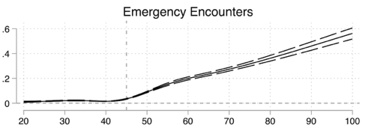

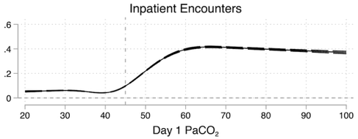
Hypercapnic Respiratory Failure is Common
Ascertainment
Table 2 | 2016 | 2017 | 2018 | 2019
Any ICD, Period Prevalence (n) | 4064 | 4104 | 4520 | 4728
Cases per 100,000 (Utah pop.) | 133.5 | 132.2 | 143.3 | 147.6
“The Consistency of Hypercapnic Respiratory Failure Case Definitions in Electronic Health Record Data”, Locke …. Peltan, Brown, CHEST (2025)

Slide 15
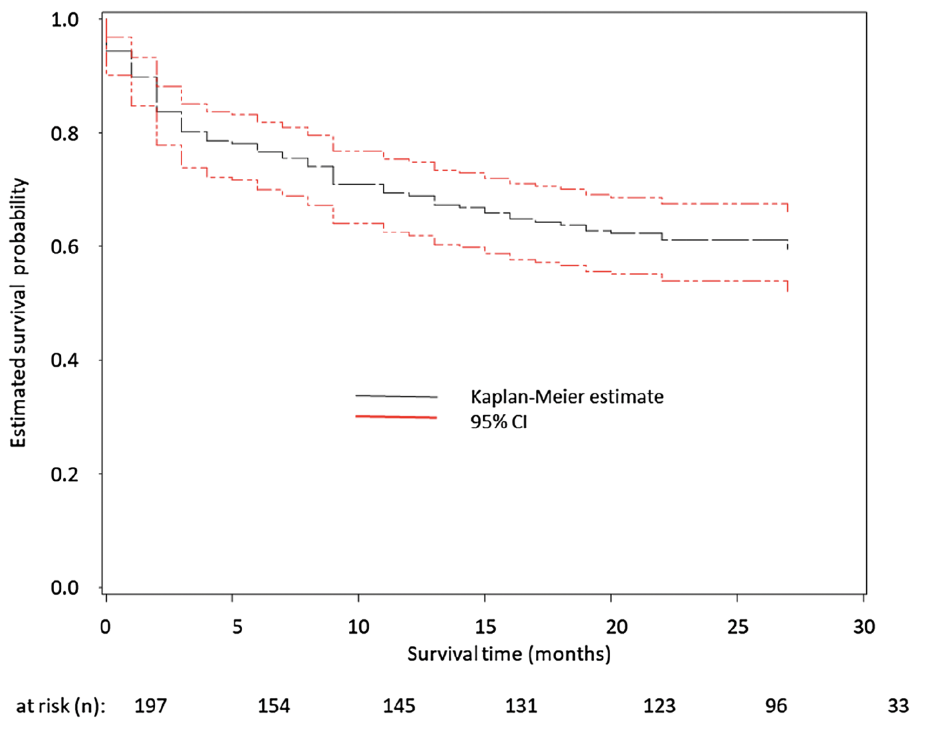
Hypercapnic Respiratory Failure is Prognostically Important
Inpatient ICD code for Hypercapnic Respiratory Failure @ U of VT
23% 30d readmission rate
Same as CHF, more than MI
Usually (66%) with recurrent hypercapnia
Notes:
What are the consequences of having hypercapnic respiratory failure?

Slide 16
Hypercapnic Respiratory Failure is Prognostically Important
TriNetX database
De-identified, patient-level data
Federated Health Record Data
80 US Healthcare Orgs
Dx code: Hypercapnic Respiratory Failure in 2022 (n=29,009)
Age (years) | 64 (±15)
Arterial PCO2 | 55.1 (±19.5)
Serum Bicarbonate (measured) | 27.1 (±7.4)
Died (1 month) | 13% (3,876)
Died (2 months) | 21% (6,089)
Month of Death | 1 (0,2)
Months to death or censoring | 9 (2,13)
EHR-recorded death | 30% (8,725)
Decompensated Cirrhosis

Slide 17
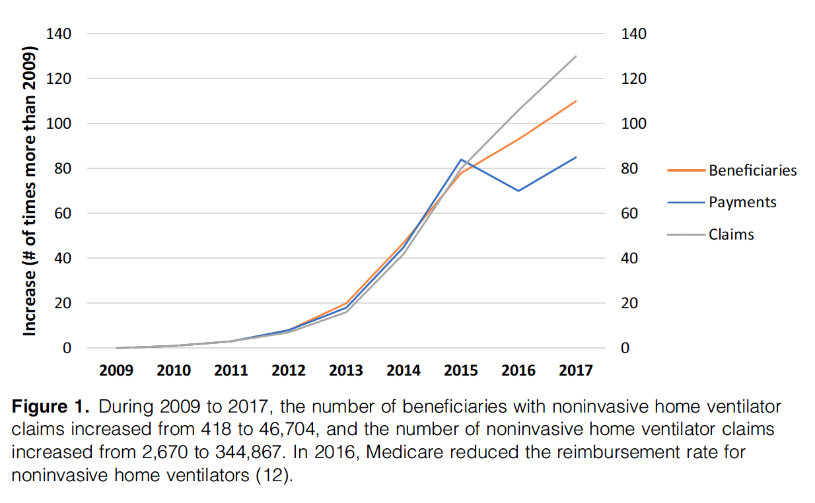


Hypercapnic Respiratory Failure is Prognostically Important
AIM-HIGH (Artificial Intelligence for Modifiable Health Indicators in Groups with High needs). w/
David Hedges, PhD
Rylan Fowers, PhD
Sam Brown, MD MSc
Notes:
Costs – to be determined
TODO: Include on of the symptoms burden assessment cohorts.

Slide 18
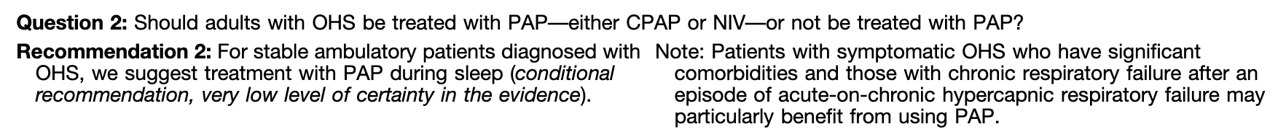

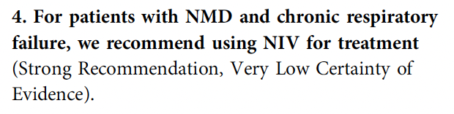
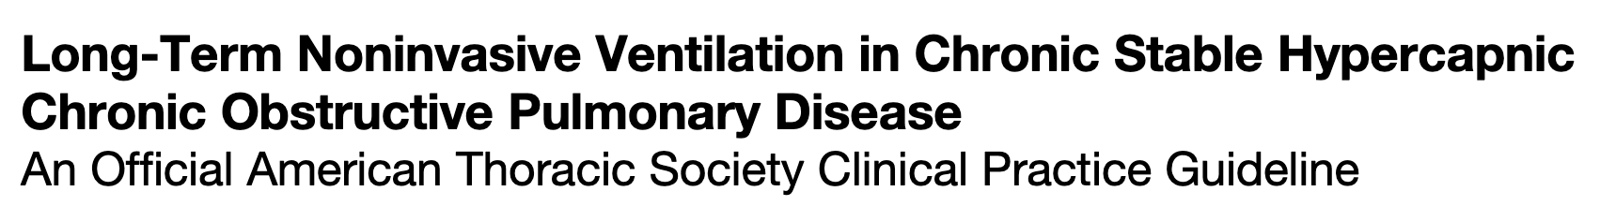
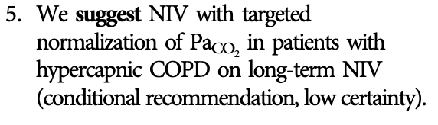
Therapeutic options exist:

Slide 19
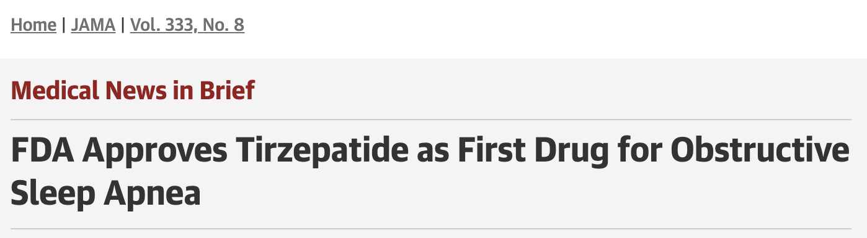
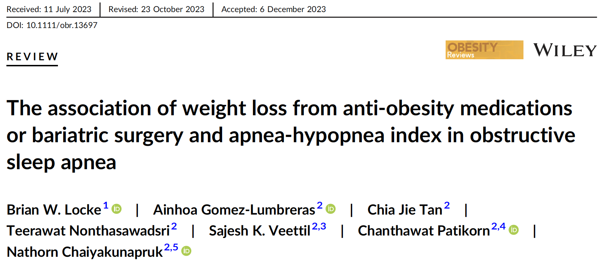
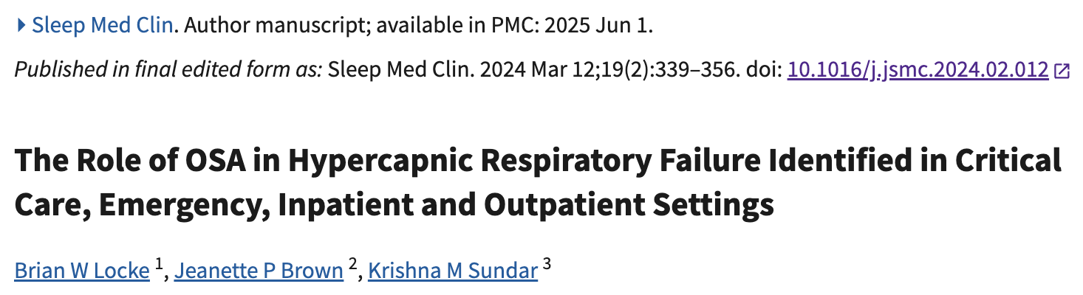
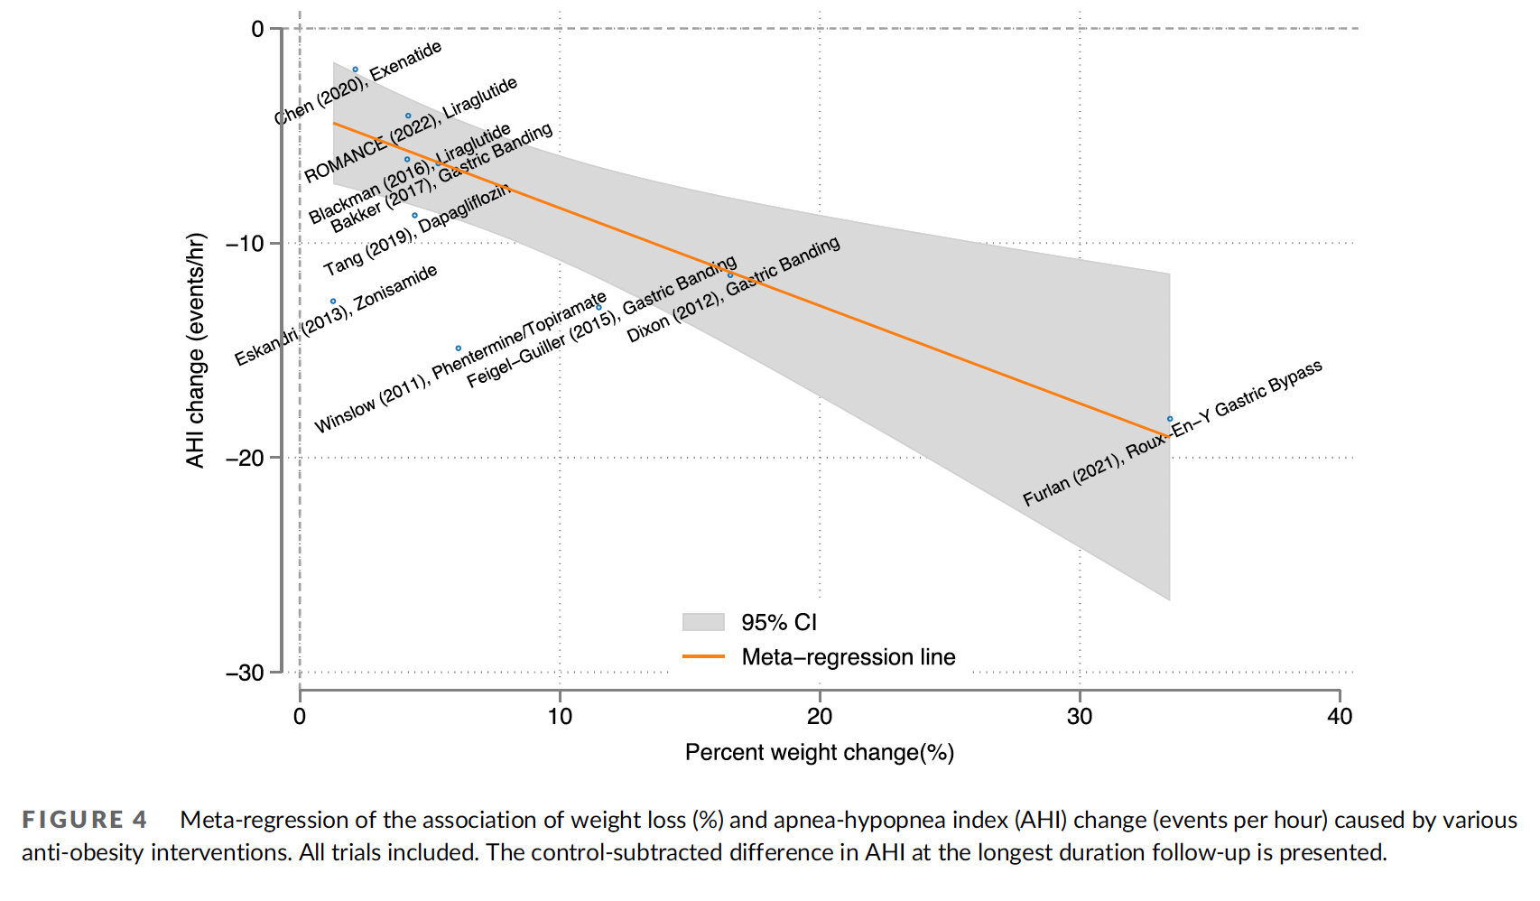
Therapeutic options exist:
Overall, OSA is identified in ICU patients with hypercapnic respiratory failure at a roughly 5-fold higher rate (63%–88% [4 studies]) when sleep testing is performed compared to when clinicians’ assessment
of the cause is used (12%, 1 study).

Slide 20
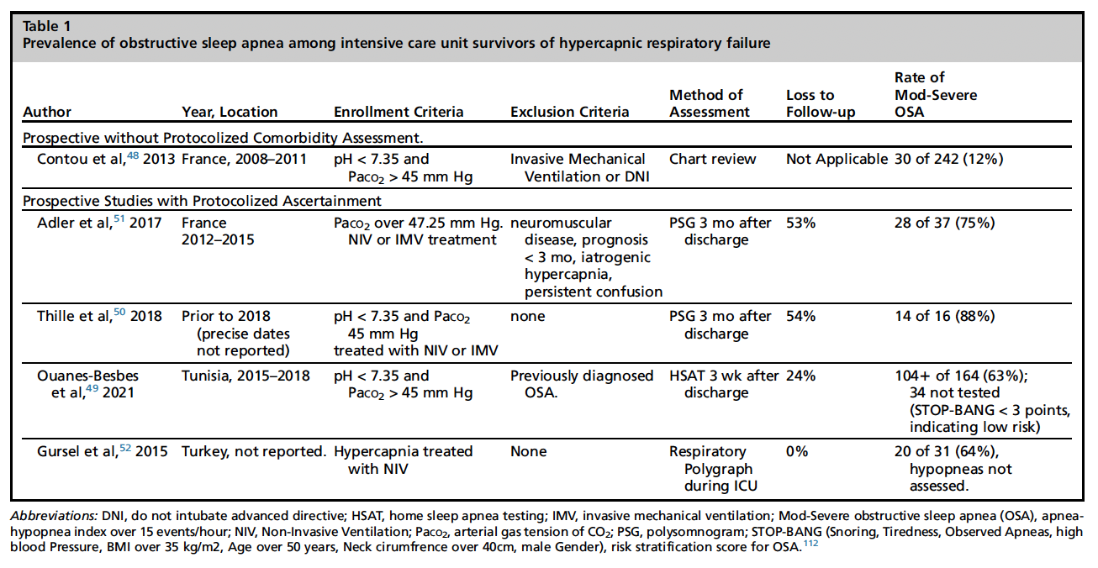
Notes:
Optional slide on the frequency of OSA among survivors of hypercapnic respiratory failure in the ICU

Slide 21

Why a CRF subspecialty (now)?
Rationale:
~300 HMV providers in U.S.
Shared therapeutic paradigms between causes (e.g. NIV, weight loss)
Distinct Skillset (vent management)
Structured care processes (e.g. DME needs, RT support, home monitoring)

Slide 22
Holes in the post-discharge hypercapnic respiratory failure evidence base stymy effective care

Slide 23
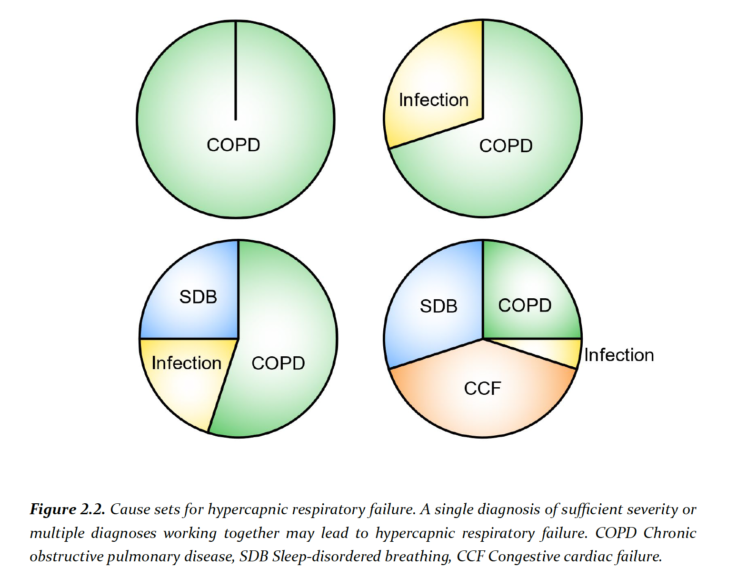
Two problems:
1. Patients in real life often have multiple contributing causes for their hypercapnia
All Recognized Cases
(Multifactorial Causes,
Relapsing-Recurrent)
???
Chronic ↑CO₂ COPD
Obesity Hypovent
ALS

Slide 24
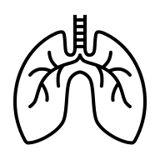
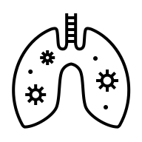





Two problems:
2. Hypercapnic respiratory failure often precedes diagnosis of the causative disease
Outpatient Diagnosis
Disease Worsens or exacerbates
Hypercapnic Resp. Failure
Stabilized
Management as per guideline
No established Diagnosis
Presentation with hypercapnia
Stabilized; outpt. workup ordered
Initial outpt. management?
Transition in care
Reliable?

Slide 25

Low diagnostic testing rates
Testing for most common causes of hypercapnia (e.g. spirometry, sleep testing) occurs after hospitalization.
Diagnostics require special resources, referrals, and high patient engagement; barriers may reduce workup completion rates.
Workup should, presumably, include tests for the commonest causes.
Identified Hypercapnia
Appropriate diagnostic testing
± Qualification for treatments
Effective management

Slide 26
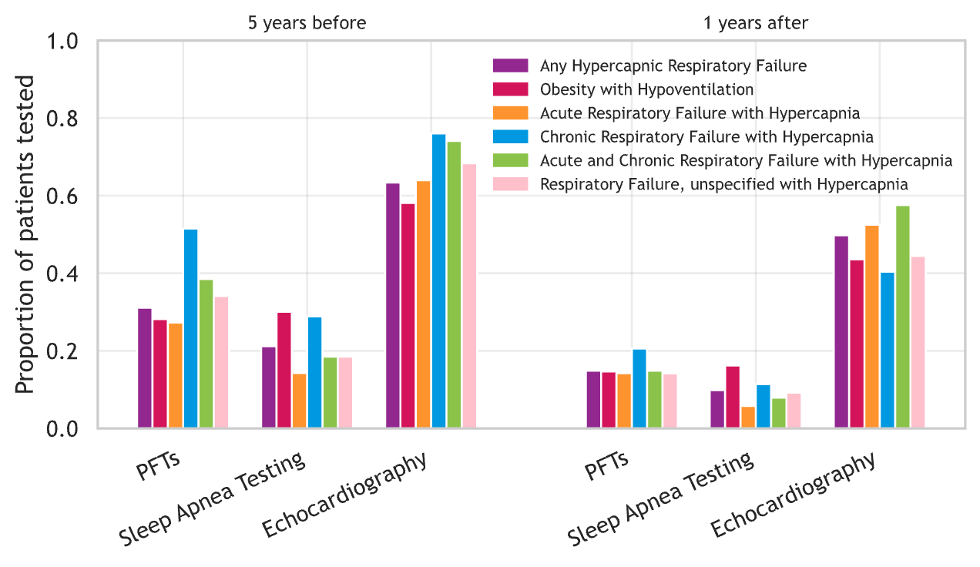
Utah All Payor Claims and Health Facilities Databases
CO₂-PATH (Post-Acute Trajectories of Hypercapnia) Cohort
All hospitalizations (90 % commercially-insured, ≈ 70 % other care from ’15-’19
Inpatient & Emergency Encounters with Hypercapnic Resp. Failure ICD-10-CM
Notes:
Hege makes the point about opiates – open question how much of a population impact this has on CHRONIC respiratory failure – for e.g. https://pmc.ncbi.nlm.nih.gov/articles/PMC10503117/ suggests not so much.
We are looking at this in the CO2-PATH cohort.

Slide 27
Post-discharge workflow:
Discharge after Hypercapnia
Discharging Provider Prescribes HMV
DME Company Receives Order
DME Company Sends RT for Setup
DME RT educates family
Discharging Provider Refers to PDNs
Scheduled with Pulm Provider
PFTs before provider visit
Discuss with Pulm provider
Discharging Provider orders Sleep Referral
In-lab PSG ordered
PSG Completed
Discuss with Sleep provider
Many(!) opportunities for pathway to de-rail
Notes:
TODO:
Patient‑journey swimlane (ideal care path): Hospital/ED → Discharge risk stratification → 7‑day clinic (empiric NIV, OSA test, spirometry) for high risk
Consider Failure points: Testing ordered but not completed; DME setup delays; unclear ownership – who educaitons patients or explains plan? Are they the right folks to do it?.

Slide 28
Clinical Implications → Ongoing Research Efforts:
Current burden of disease and health system performance needs further benchmarking
Patients with hypercapnic respiratory failure by ICD, ABG, VBG → testing, emergency care, and mortality rates across the state (CO₂-PATH Cohort)
Risk-based, rather than diagnosis-based, referral method likely optimal to allow expedited workup and empiric management when needed
Testing needs; qualification criteria; early post-discharge coordination.
Risk stratification (cost, utilization) of patients with hypercapnic respiratory failure who receive care at Intermountain via Select Health (AIM-HIGH)

Slide 29
Chronic Resp. Failure @ Schmidt: capacity and referral gates
Three referral streams:
High-risk post-discharge (via PDNs)
Internal clinic referrals/comgmt potential NIV starts
Neuromuscular disorders clinic
Additional potential sources:
PMR, post-acute facilities, Re-triage from Sleep.
Tele pulmonary / Remote?
Referral criteria? (~500 ICD; 4000 blood gas yearly system-wide)
How to refer: iCentra/Epic message (Brian Locke) or brian.locke@imail.org
50ish patients managed.
PDNs: Claire Davies and Megan Hepworth
~1 clinic per week & add’n PDN visits
Notes:
Note that the potential for remote monitoring is high – can deliver pretty good care with remote tracking downloads and video visit (population often has mobility challenges anyway).
[ ] need to determine optimal referral / triage criteria
Emphasize – optimal referral is in folks who may need NIV (can help make that determination), even if exhaustive testing not completed, rather than requiring it be certain.

Slide 30
64F w/ BMI 38, “COPD”– no testing. Readmit. Tx for ‘PNa/AECOPD/CHF’ PaCO₂ 95. HCO₃⁻ 38. What device can we get?
Notes:
Say, you’ve decided they need a device… how do we get one?

Slide 31
Devices for home non-invasive ventilation:
Respiratory Assist Devices (RAD) | Home Mechanical Ventilator (HMV)
HCPCS code E470 (spontaneous) or E0471 (backup rate) | HCPCS code E0465, E0466*, E0467
BPAP, BPAP-ST, VAPS | Add: Adjustable EPAP (AVAPS-AE), mouthpiece vent, HFNO, trach vent.
Pressure max ~25-30 cmH₂O | Pressure max ~50-60 cmH₂O
Requires outlet | Battery power
Remote setting adjustment | No remote setting adjustment
E.g. Aircurve ST, Aircurve STA, Luna G3 | Trilogy (EVO), Astral , Vivo, Luisa, VOCSN
Rent-to-own | Rent
No home support | Home RT support
Mean IPAP in contemporary COPD trials mid 20s.
Notes:
PAP invented for Sleep Apnea → CMS worried: $ for all OSA to get home vents? Rebranded BPAP as “Respiratory Assist Device” to assure that not everyone going to need a ventilator.
E0465/E0466/E0467

Slide 32
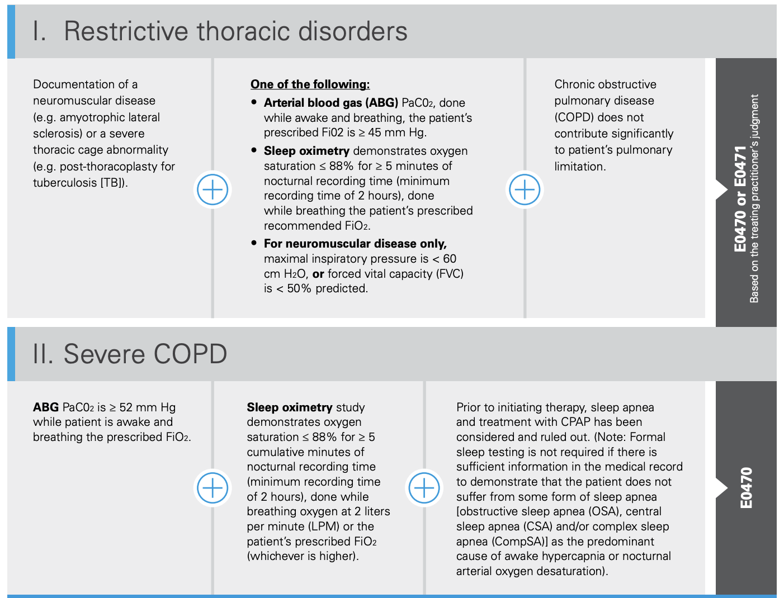
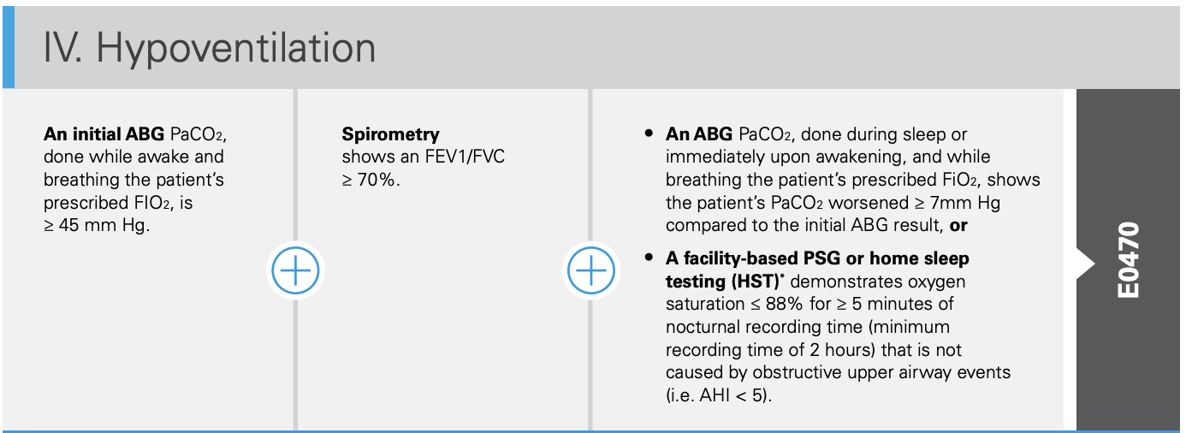
Prior National Coverage Determination: RADs

Slide 33
New NCD for RADs
NMD: No change
“COPD” Outpatient | “COPD” on Discharge
Chronic Respiratory Failure Dx [“COPD” includes all non OSA hypercap]. No PFTs required | Acute on Chronic Respiratory Failure Dx. No PFTs required
PaCO2 ≥ 52 mmHg 2+ weeks after hosp or without exac of symptoms | document full settings of RAD use within 24h of discharge
Sleep apnea is not the sole cause. No PSG or ONO required. | RAD needed to avoid symptoms or rapid PaCO₂ rise
Q6month Continued Usage Criteria: confirm medically necessary, avg 5h/24hr usage, and any of improved (CO₂, exacerbations, symptoms)
Notes:
COPD is more of a vibe than a diagnosis now. -> prepare for huge amounts of confusion about diagnosis (already a big problem)
COPD pathway includes ILD, overlap, etc. … basically everything that isn’t OSA and NMD

Slide 34
Prior National Coverage Determination: HMVs
Patient has a NMD, Thoracic Restrictive Disease, or Chronic Respiratory Failure from COPD
Where “the condition is life-threatening where interruption of respiratory support would quickly lead to serious harm or death.”
Unlike RADs, no definitions of medical conditions or what constitutes life-threatening were given
Notes:
Use of a noninvasive ventilator in the home setting may be considered medically necessary when both of the following criteria are met (A. and B.):
A. The device is being requested to treat any of the following
Indications:
1. Neuromuscular disease
* 2. Thoracic restrictive disease
3. Chronic respiratory failure consequent to chronic obstructive pulmonary disease.
B. There is sufficient documentation in the medical record to support the condition is life-threatening where interruption of respiratory support would quickly lead to serious harm or death.
Il. Use of a noninvasive ventilator in the home setting is considered not medically necessary when Criterion I. is not met, including but not limited to the following situations:
﻿﻿﻿The patient's condition is such that treatment may be adequately provided by a bilevel positive airway pressure device
﻿﻿﻿Severity of the patient's condition is not severe and life-threatening.
There are no definitions for these medical conditions (Unlike the RAD criterion)
﻿﻿"Adequately provided by bilevel" is not defined in the E0466 NCD
• • ﻿﻿"Life threatening interruption" is not defined in the E0466 NCD

Slide 35
New NCS for HMVs
“COPD” Outpatient | “COPD” on Discharge
Qualify for RAD + 1 of: | Acute on Chronic Respiratory Failure Dx with PaCO₂ 52 mmHg
Need volume targeted mode IPAP must be over 20 cmH2o Failure of RAD to improve symptoms, CO₂, or exacerbations | HMV needed to avoid symptoms or rapid PaCO₂ rise “capabilities exceed RAD” (e.g. vol targeted)
Need FiO2 > 36% (~4L) 8+ hr/day use Need battery | document full settings of HMV use within 24h of discharge
Q6month Continued Usage Criteria: confirm medically necessary, avg 5h/24hr usage, and any of improved (CO₂, exacerbations, symptoms)

Slide 36



Contact: brian.locke@imail.org or EHR message
Notebook LM on Hypercap. R.F.
With research support from:
The Intermountain Foundation
ATS ASPIRE Fellowship
NIH/NHLBI T32 University of Utah PCCM
Partial support for all datasets within the Utah Population Database provided by:
U of Utah Huntsman Cancer Institute (HCI)
HCI Cancer Center Support grant P30 CA2014 from the National Cancer Institute
Clinical Support from
PDNs (Claire Davies and Megan Hepworth)
Schmidt Chest Clinic
Intermountain Health:
Ithan Peltan, MD MSc
Sam Brown, MD MSc
Select Health:
Rylan Fowers, PhD
David Hedges, PhD
Utah Population Database:
Myke Madsen, MStat
Marie Gibson, CCRP
University of Utah:
Ram Gouripeddi, MBBS MSc
Jeanette Brown MD PhD
Joseph Finkelstein MD PhD
University of California, Davis:
Krishna Sundar, MD

